Slide 1
NEH Information Session &
Application-Writing Workshop
CLASP Conference, Thursday, November 5, 2015
Thank you to our organizers!

Slide 2
NEH 101
NEH is supported by your tax dollars and is responsible to you
Notes:
Tax payer responsibility. If you apply, you should expect privacy; full and fair review; feedback on your application. Think of NEH as a consulting service rather than an ATM.

Slide 3
NEH 101
NEH is supported by your tax dollars and is responsible to you
NEH makes awards in all areas of the humanities
Notes:
Interdisciplinary work. Work on the edges of traditional humanities. Don’t fund advocacy, works of art, etc.

Slide 4
NEH is supported by your tax dollars and is responsible to you
NEH makes awards in all areas of the humanities

Slide 5
NEH 101
NEH is supported by your tax dollars and is responsible to you
NEH makes awards in all areas of the humanities
Help and resources are always available
Notes:
Phone; email; staff composition designed to help you.

Slide 6
NEH 101
NEH is supported by your tax dollars and is responsible to you
NEH makes awards in all areas of the humanities
Help and resources are always available
Awards made through seven grant-making divisions and offices

Slide 7
Federal/state partnership ($42.4 M)

Slide 8
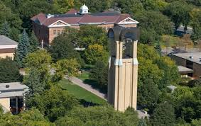
Challenge grants ($8.4 M)
Institution-building grants to carry out long-term plans for strengthening basic humanities resources, community building, and access to humanities programs.

Slide 9
Deadlines
Next Generation Humanities PhD – February 17
TBA (community and access grants) – May 1
Examples
Augustana College: “Strengthening the Endowment of Augustana College’s Center for Western Studies” $300,000, 4:1 match
Gettysburg College: “Expanding Civil War Era Studies” $500,000, 3:1 match

Slide 10
Office of Digital Humanities ($4.4 M)
Encourages innovations in the digital humanities through research that brings new approaches or documents best practices; creation of digital tools for preserving, analyzing, and making accessible digital resources; and examination of the philosophical implications and impact of emerging technologies.
Notes:
Our Office of Digital Humanities is supporting a lot of cutting-edge work in incorporating technology into research and public engagement in the humanities. This includes creating new tools and collaborating on new research approaches.

Slide 11
Deadlines
Digital Humanities Start-Up Grants—September 21
Digital Humanities Implementation Grants—February 17
Institutes for Topics in the Digital Humanities—March 15
Examples
Wheaton College: Digital Start-Up Grant for “Easing Entry and Improving Access to Computer-Assisted Text Analysis in the Humanities.” $60,000
Middlebury College: A two-week institute for college teachers on “Scholarship in Sound and Image: Producing Videographic Criticism in the Digital Age” $95,152

Slide 12
Division of ($13.2 M)
Grants to strengthen teaching and learning through new or revised curricula and materials, collaborative study, seminars, and institutes.
Notes:
The education division has programs that support teaching, for both college and pre-college classrooms. You have a sheet describing the division’s programs.

Slide 13
Deadline
Landmarks, Seminars, and Institutes—February 25
Enduring Questions ? — TBA
Humanities Initiatives at HBCUs, TCUs, and HSIs and two-year colleges—June 23
Examples
Concordia College: “How Can Meaning Be Found When a Culture Has Been Lost?” $25,000 (Enduring Questions)
Gustavus Adolphus College: Three-week seminar on “Roman Daily Life in Petronius and Pompeii.” $92,550 (Summer Seminars for School Teachers)
Siena College: Two, one-week seminars on “Religious Revival, Utopian Society, and the Shaker Experience in America.” $169,426 (Landmarks of American History)

Slide 14
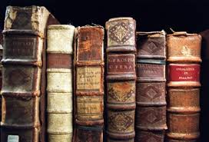
Division of Preservation & access ($15.4 M)
Grants to preserve archival holdings (including digitization); enhance access to materials; train preservationists; and produce reference works for scholarly research, education, and public programming.

Slide 15
Deadlines
National Digital Newspapers—January 14
Preservation Assistance Grants—May 3
Preservation Research and Development—June 21
Collections and Reference Resources—July 19
Sustaining Cultural Heritage Collections—December 1
Examples
St. Vincent College – “Assessing the Care and Preservation of the Special Collections of the St. Vincent College Latimer Family Library” $6,000 (Preservation Assistance Grants)
Bard College: “Milosevic Trial Public Archive.” $40,000 (Humanities Collections and Reference Resources)
Gettysburg College – “Documenting Traditional Ecological Knowledge among Nuhuat and Totonac Speakers.” $200,000 (Documenting Endangered Languages)

Slide 16
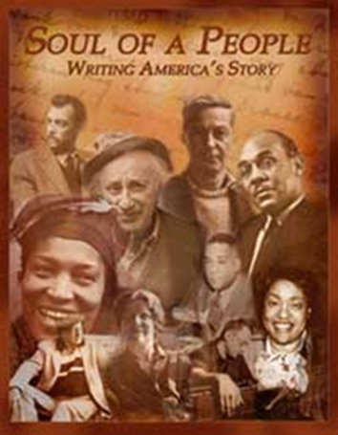
Division of Public Programs ($13.7 M)
Grants for the presentation of the humanities for large and diverse public audiences. Grants typically support radio and television documentaries, exhibitions and interpretation of historic sites, reading and discussion series, lectures, symposia, and after school programs.
Notes:
The Division of Public Programs supports a wide range of public humanities programs that reach large and diverse public audiences. Fundable activities include, but are not limited to, radio and television programs for national broadcast, exhibitions and interpretation of historic sites, reading or film discussion series, lectures, and symposia. You will see on the Public Programs sheet a description of the grant programs.

Slide 17
Deadlines
Media—January 13
Museums, Libraries, and Cultural Institutions— January 13
Digital Projects —June 8
Examples
Institute for Contemporary Art, “Leap Before You Look: Black Mountain College, 1933-1957” $400,000 (a traveling exhibition, Museums, Libraries, and Cultural Institutions)
Twin Cities Public Television, “Stalin: a two hour documentary,” $600,000 (Media)
Richard Stockton College, “Pox in the City: A 3-D Strategy Game for the History of Medicine” $99,837 (Digital Projects)

Slide 18
Division Of Research Programs ($14.7 M)
Grants support individuals and teams of scholars pursuing advanced research in the humanities that will contribute to scholarly knowledge or to the general public's understanding of the humanities.
Notes:
Third, the Division of Research Programs. This division supports the work of scholars, working individually or in teams, doing research for scholarly and general audiences. You have a sheet describing all of the division’s grant programs. These include the Fellowship, probably the best-known of the Endowment’s grants. That’s what people are talking about when they say “Oh, that person got an NEH!”

Slide 19
Deadlines for Individual Scholars
Public Scholar (4-12 months) – February 2
Awards for Faculty * (3-12 months) – April 14
Fellowships (6-12 months) – April 28
Summer Stipends (8 weeks) – September 29
Examples
Susan Hiner, Vassar College: “Women, Fashion, and Work in 19th-Century France.” $37,800 (Fellowship)
Dennis Frost, Kalamazoo College: “The Paralympic Movement, Sports, and Disability in Postwar Japan.” $6,000 (Summer Stipend)
Michael Gorra, Smith College: “William Faulkner’s Civil War” $50,400 (Public Scholar)
Natale Zappia, Whittier College: “Food Frontiers: Indigenous and Euro-American Ecologies in Early America” $25,200 (Awards for Faculty)
* Open only to faculty at HBCUs, HSIs, and TCUs

Slide 20
Also for Individual Scholars
Fellowship Programs at Independent Research Institutions
Library of Congress - Kluge Fellowships
NEH-Japan US Friendship Commission – Advanced Social Science Research on Japan fellowships
NEH-National Science Foundation – Documenting Endangered Languages fellowships

Slide 21
Deadlines for Teams of Scholars
Scholarly Editions and Translations – December 9
Collaborative Research – December 9
Examples
Connecticut College: “Kierkegaard’s Journals and Notebooks” $225,000 (Scholarly Editions and Translations)
Skidmore College: “Assembling the Mayan Mural Fragments from San Bartolo, Guatemala,” $185,000 (Collaborative Research-archaeology)
St. Olaf College: “Russia's Dissident Old Believers” $41,000 (Collaborative Research-conferences)
Macalester College: “Technology Transfer at Work in China-Africa Development Assistance: The TAZARA Railway, 1968-1986” $151,000 (Collaborative Research)

Slide 22
The Common Good Initiative
“This initiative seeks to connect the study of the humanities to the current conditions of national life. Many of today’s challenges require more than ever the forms of understanding and knowledge represented by the humanities. They require the broadest possible engagement of scholars and the public with the resources of the humanities, including but not limited to the study of language, literature, history, philosophy, comparative religion, and ethics. The study of the humanities can help illuminate the complexity of many contemporary challenges while enriching our understanding of the common good.”

Slide 23
Dialogues on the Experience of War
Through the Division of Education, this program supports the study and discussion of important humanities sources about war, in the belief that these sources can help U.S. military veterans and others to think more deeply about the issues raised by war and military service. The humanities sources can be drawn from history, philosophy, literature, and film—and they may and should be supplemented by testimonials from those who have served.
Deadline: September 15

Slide 24
Public Scholar
Through the Division of Research Programs, the Public Scholar program supports well-researched books in the humanities intended to reach a broad readership. Books supported by this program must be grounded in humanities research and scholarship, must address significant humanities themes likely to be of broad interest, and must be written in a readily accessible style.
Deadline: February 2

Slide 25
Humanities Open Book Program
Through the Office of Digital Humanities and in cooperation with the Mellon Foundation, the Humanities Open Book Program enables publishers and presses to digitize out of print books for free download and distribution to the public.
Deadline: June 2016

Slide 26
Common Heritage Program
Through the Division of Public Programs and the Division Preservation and Access, the Common Heritage Program seeks to engage communities and individuals in the preservation of important historical documents and create community outreach using these documents. Awards are open to community institutions (libraries, museums, etc.)
Deadline: June 2016

Slide 27
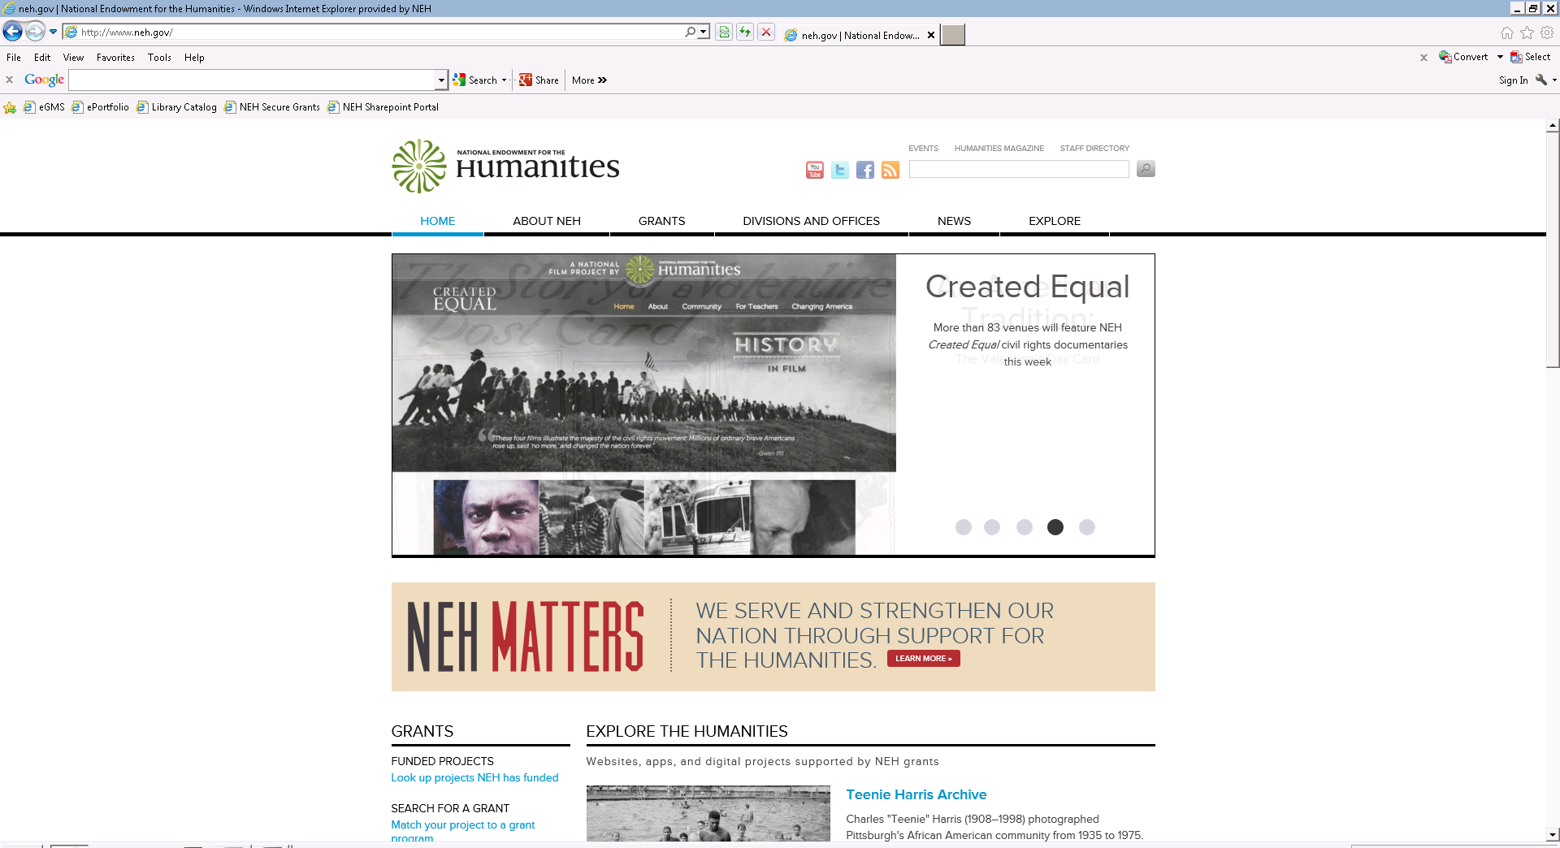
Resources

Slide 28
Resources

Slide 29
Resources

Slide 30
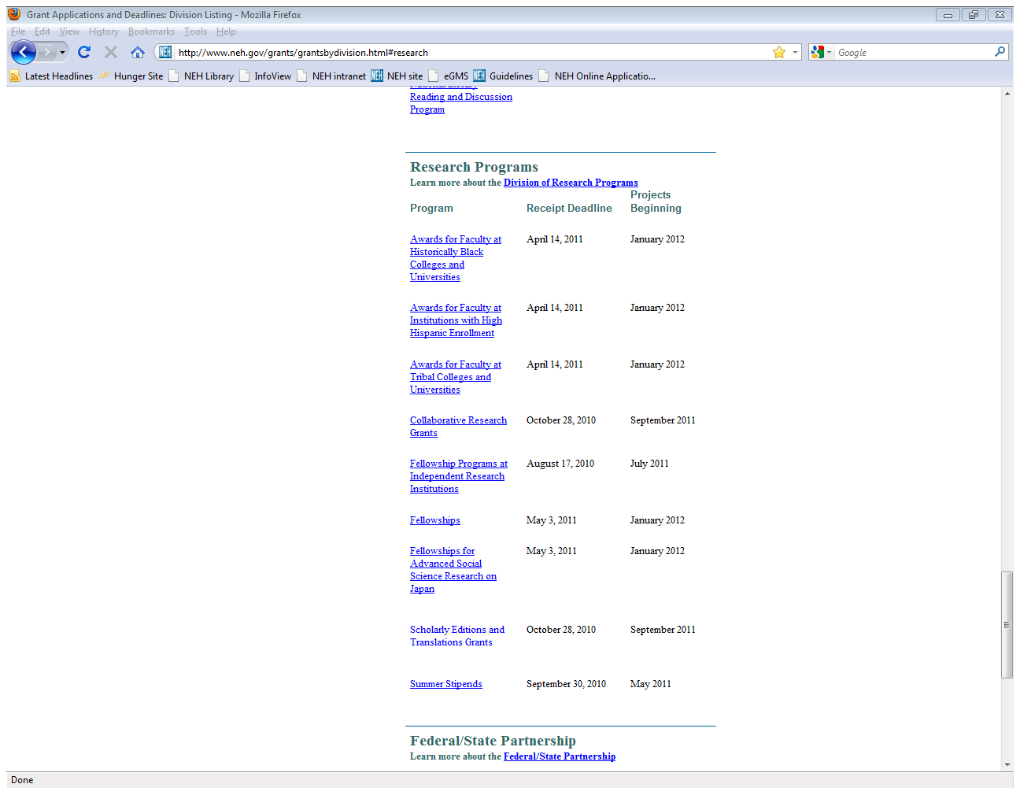
Resources

Slide 31
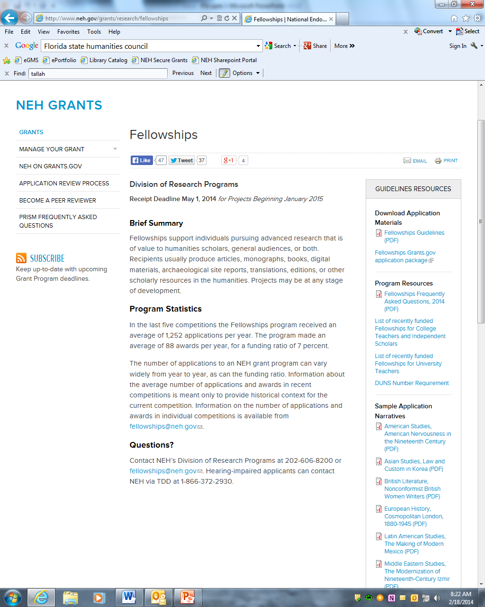
Resources

Slide 32
Questions?
Russell Wyland, Deputy Director
NEH Division of Research
400 7th Street, SW
Washington, D.C. 20506
RWyland@neh.gov
202-606-8391
Also: research@neh.gov / 202-606-8200

Slide 33
Mock Panel Review

Slide 34
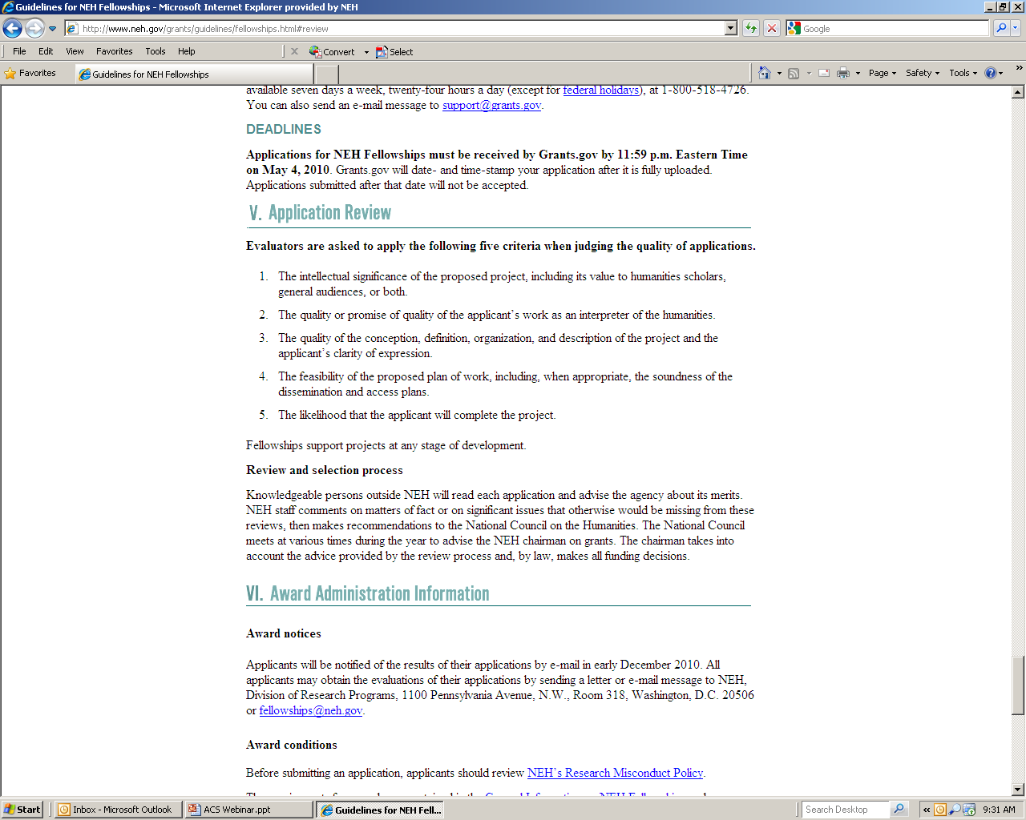

Slide 35
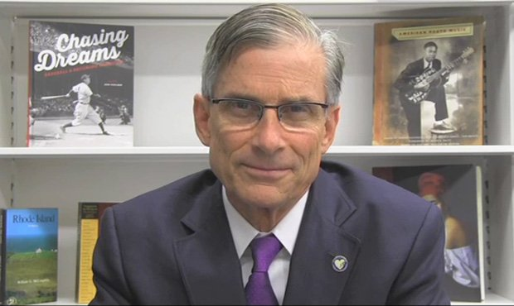
Stages of Review
Peer Review Panelists
NEH staff
National Council
Chairman
http://www.neh.gov/grants/application-process

Slide 38
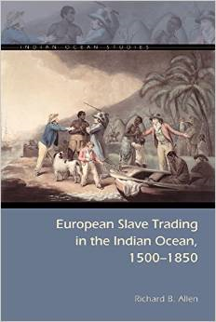
Notes:
Richard B. Allen, Framingham State College. Ohio University Press, 2014

Slide 39
Notes:
Colin Wells is finishing up his project on poetry wars. He is in the Department of English at St. Olaf College in Northfield, MN

Slide 40
Notes:
Gayle Sulik is currently a part-time associate professor at SUNY, Albany.

Slide 41
Questions?
Russell Wyland, Deputy Director
NEH Division of Research
400 7th Street, SW
Washington, D.C. 20506
RWyland@neh.gov
202-606-8391
Also: research@neh.gov / 202-606-8200

